Slide 1
9@9
Building a better new hire experience in Onboarding
Notes:
Good morning and welcome to the 9@9. Today we will be discussing what you can do to make the new hire experience feel a little more welcoming.

Slide 2
Today's Presenter
Hugo Ramirez
Customer Success Specialist

Slide 3
New Hire Onboarding Experience

Slide 4
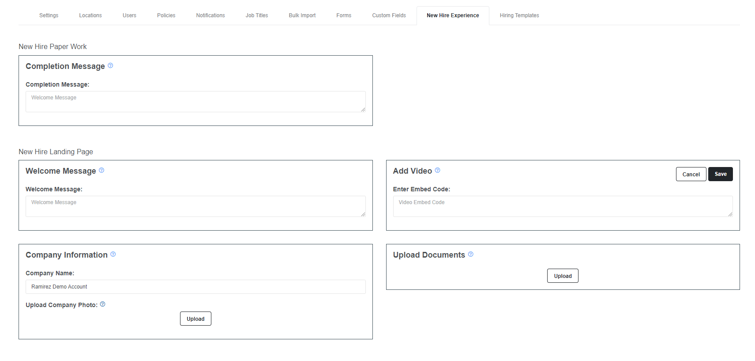
New Hire Experience Overview
Notes:
We will be looking at the new hire experience page to help build a New Hire Landing page – Adding some helpful information to the page will help welcome new hires and get them started.

Slide 5
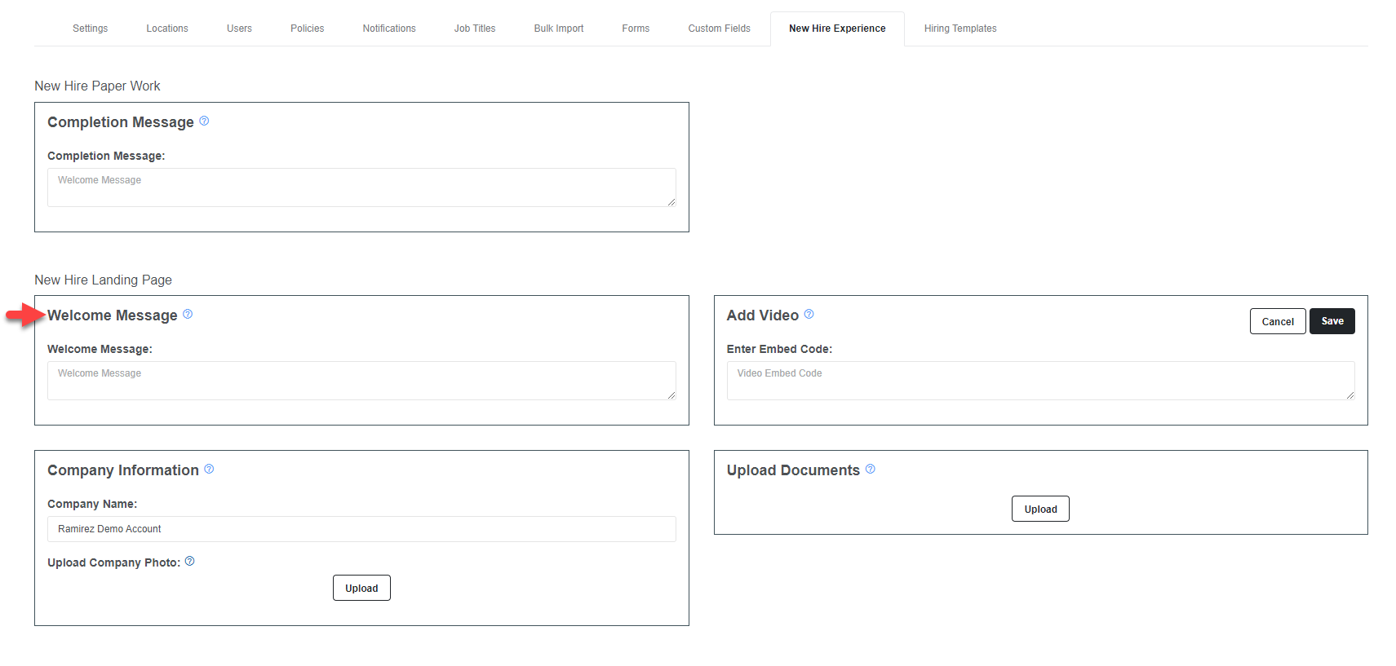
Welcome Message
Notes:
Use this section of the page to inform the new hire of any documents they can download as well as a general welcome to the onboarding page.

Slide 6
Welcome Message
Welcoming and informational
Should not be longer than a sentence or two.
Notes:
Use this section of the page to inform the new hire of any documents they can download as well as a general welcome to the onboarding page.

Slide 7
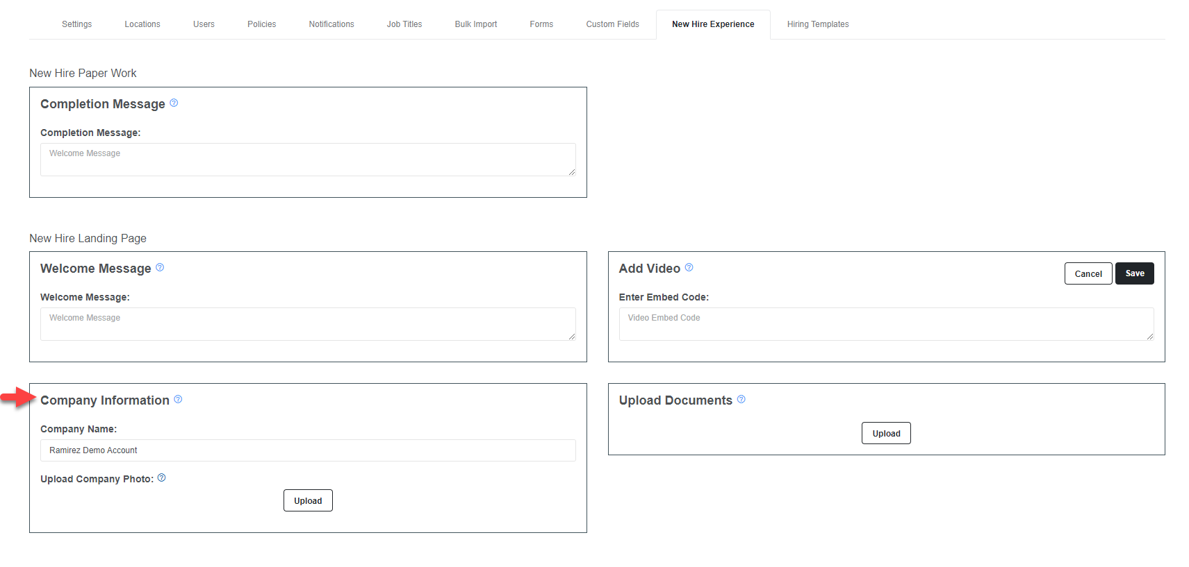
Company Info
Notes:
This section will identify your company name on the new hire landing page.
You will also have the opportunity to add any photos you want to help convey the culture at your company.
The minimum height is 315px. The length stretches by the size of the screen (responsive), so select an image that is horizontal or 2.5:1 ratio.
A good recommendation size/scale is 600px wide by 145px tall (limit is 744px wide by 298px tall).

Slide 8
Company Info
Company Name – Display your company name on the landing page
Company Photo – Can be JPG or PNG Format
The minimum height is 315px. The length stretches by the size of the screen (responsive), so select an image that is horizontal or 2.5:1 ratio.
A good recommendation size/scale is 600px wide by 145px tall (limit is 744px wide by 298px tall).
Notes:
This section will identify your company name on the new hire landing page.
You will also have the opportunity to add any photos you want to help convey the culture at your company.
The minimum height is 315px. The length stretches by the size of the screen (responsive), so select an image that is horizontal or 2.5:1 ratio.
A good recommendation size/scale is 600px wide by 145px tall (limit is 744px wide by 298px tall).

Slide 9
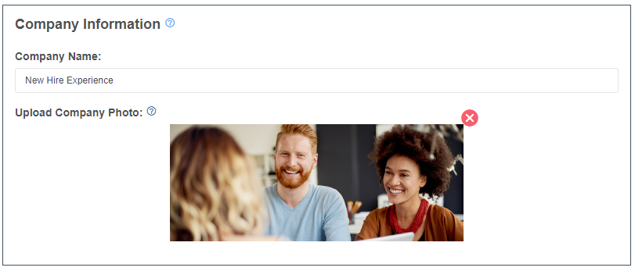
Company Info
Company Name – Display your company name on the landing page
Company Photo – Can be JPG or PNG Format
The minimum height is 315px. The length stretches by the size of the screen (responsive), so select an image that is horizontal or 2.5:1 ratio.
A good recommendation size/scale is 600px wide by 145px tall (limit is 744px wide by 298px tall).

Slide 10
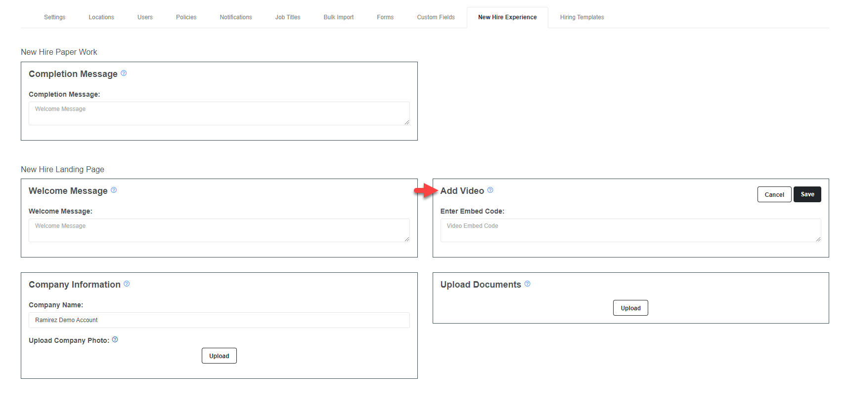
New Hire Video
Notes:
Upload your video to a host like youtube, the videos are not hosted by Arcoro.
Grab the embed code by selecting the share button
Paste code into Video Embed Code Section and save

Slide 11
New Hire Video
Upload video to your favorite video host
Grab the embed code
Add the code to Video Embed Code section
Notes:
Upload your video to a host like youtube, the videos are not hosted by Arcoro.
Grab the embed code by selecting the share button
Paste code into Video Embed Code Section and save

Slide 12
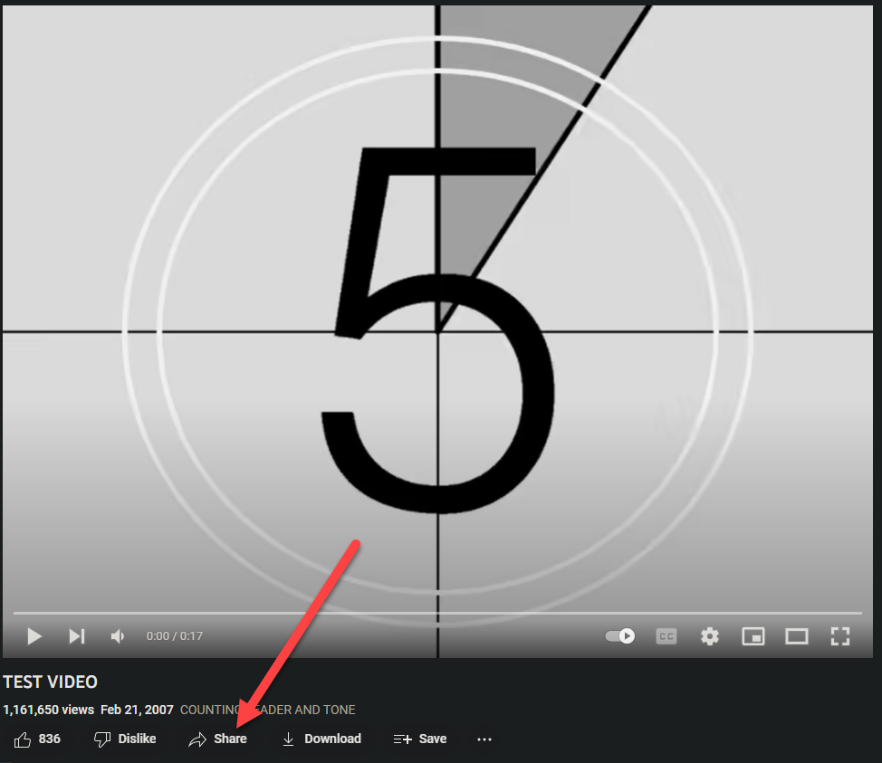
New Hire Video
Upload video to your favorite video host
Notes:
We are using youtube as an example we do not host video on our servers.

Slide 13
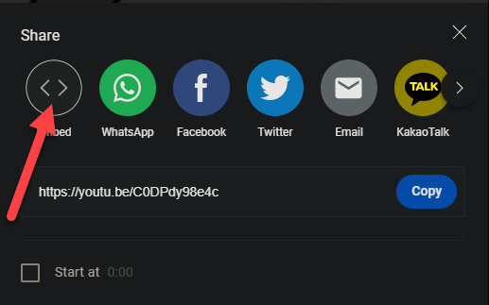
New Hire Video
Grab the embed code

Slide 14
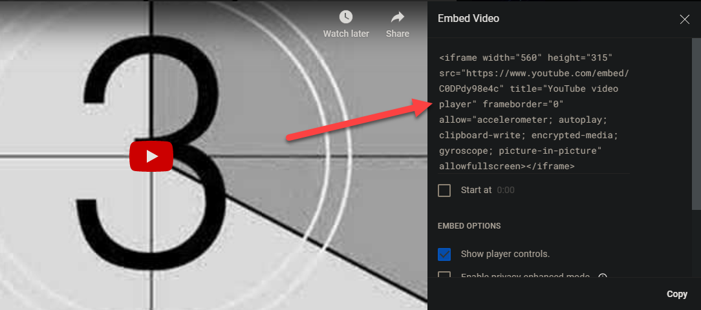
New Hire Video
Grab the embed code

Slide 15
New Hire Video
Add code the Video Embed Code
Notes:
Make sure to save after adding the code into the embed code section.

Slide 16
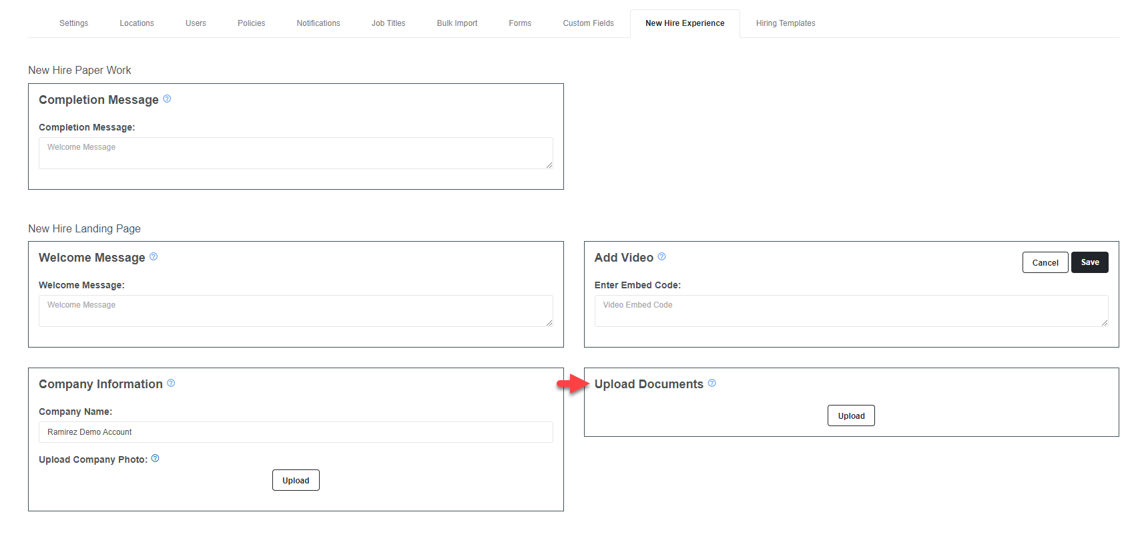
Documents
Notes:
Upload any helpful documents that your new hire may require like employee handbook.

Slide 17
Documents
Upload anything educational and helpful to the new hire.
Handbook, Safety Guides, Company dress code, ETC.
File must be PDF and max file size is 100mb per document.
Notes:
Upload any helpful documents that your new hire may require like employee handbook.

Slide 18
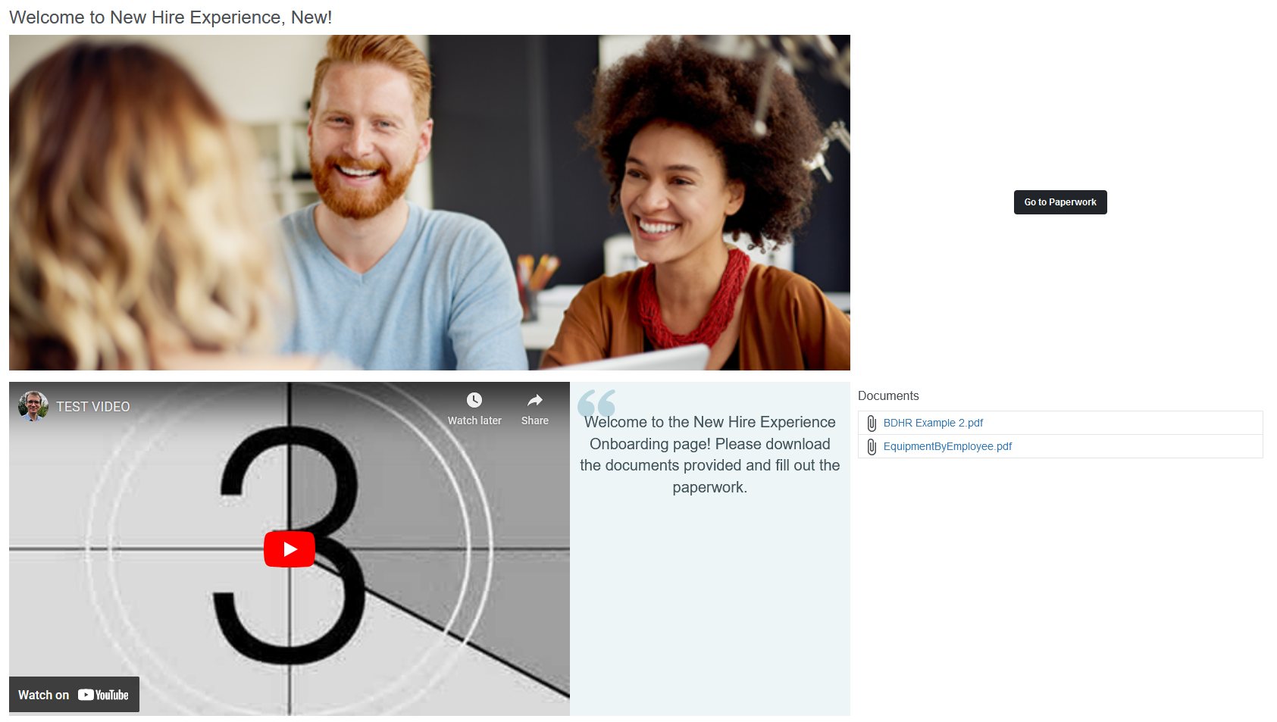
Landing page
Notes:
Upload any helpful documents that your new hire may require like employee handbook.

Slide 19
Recap
Welcoming New Hire experience
Adding Photos
Adding a video
Adding some documents for new hires

Slide 20
Thank you
Hugo Ramirez – Customer Success Specialist
Notes:
This will end our look into the new hire experience. Thank you for attending our 9 at 9 session.

